Slide 1

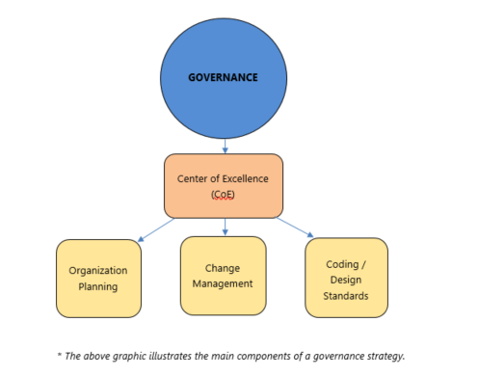
INAP – Company Rebrand & Marketing Fundamentals
Business Need
INAP recently transitioned from Internap to INAP, so one of the first tasks involved re-establishing brand awareness, improving brand reputation and formerly documenting marketing fundamentals. This work would involve updating their style guide, redesigning their main website; evaluating and revising buyer personas and implementing governance.
What We Did
Affirma performed an extensive heuristic evaluation of INAP’s website, including competitor analysis, in order to provide detailed findings and recommendations for improved site-wide navigation and header/footer UX. Design comps were provided as well.
In addition, Affirma provided the following:
  Governance Strategic Framework
  Naming Convention Specification
  Lead Management Procedure and process documents
  Style Guide best practices
  Buyer Persona workshops and recommendations

